Slide 1
INTRODUCTION TO
PATHOLOGY
Dr.Kaduyu Dennis
SUBTOPIC 1CONCEPTS TO PATHOLOGY
SUBTOPIC 2CAUSES,CLASSIFICATION AND PATHOGENICITY OF DISEASES
SUBTOPIC 3 PHYSIOLOGIC STRESS AND PATHOLOGICAL INJURY AND CELLULAR ADAPTATION
SUBTOPIC 4CELL INJURY AND CELL DEATH

Slide 2
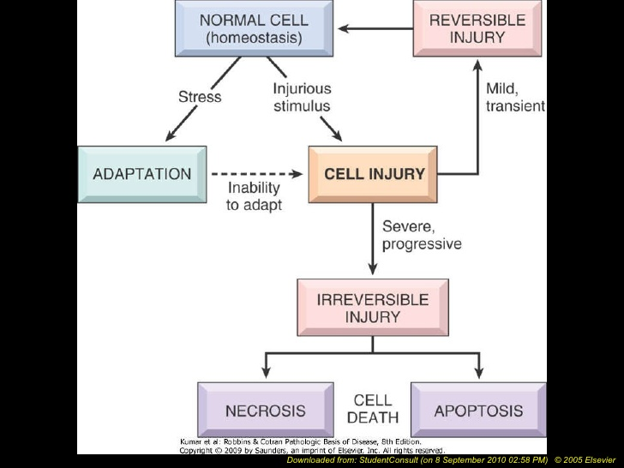
Cellular response to injury
LECT
Dr. Olwa Francis

Slide 3
CELLULAR ADAPTATION MXMS
LEARNING OBJECTIVES
Terminologies used in cellular reaction to injury
Mechanisms of adaptation to cellular injuries

Slide 4
TERMINOLOGIES USED IN CELLULAR RXN TO INJURY
CELLULAR ADAPTATION TERMINOLOGIES Hypertrophy,Atrophy,Hyperplasia,Metaplasia,
Dysplasia
CELL INJURY TERMINOLOGIES
Reversible cell injury
Irreversible cell injury
Necrosis
Apoptosis

Slide 5
Cellular response to injury
LECT
Dr. Olwa Francis

Slide 6
Definition
Cellular adaptation refers to changes made by a cell in response to adverse environmental internal or external stress
For the sake of survival on exposure to stress, the cells make adjustments with the changes in their environment (i.e. adapt) to;
The physiologic needs (physiologic adaptation)
OR
Non-lethal pathologic injury (pathologic adaptation).

Slide 7
Broadly speaking such physiologic and pathologic adaptations occur by the following processes
Hypertrophy: increase in the size of cells
Atrophy: decrease in the size of cells
NB Postfix “ Trophy” means ;size
Hyperplasia: increase in the number of cells
Metaplasia: change where one cell type is replaced by another cell type; e.g. columnar epithelium transforming into stratified squamous epithelium
Dysplasia: abnormal development of cells
NB Postfix “plasia” means growth of new cells
Prefix “ meta”- transformation, “Dys” –bad development

Slide 8
In general, the adaptive responses are reversible on withdrawal of stimulus. However, if the irritant stimulus persists for long time, the cell may not be able to survive and may either die or progress further e.g. cell death may occur in sustained atrophy; dysplasia may progress into carcinoma in situ
REMEMBER
2 TROPHY; Atrophy,hypertrophy
3 PLASIA; Hyperplasia,metaplasia and dysplasia

Slide 9
HYPERTROPHY
Hypertrophy is an increase in the size of cells that results in an increase in size of affected organ or tissue, without any change in the number of cells.
CAUSES. Hypertrophy may be physiologic or pathologic. In both cases, it is caused either by increased functional demand or by hormonal stimulation. Hypertrophy without accompanying hyperplasia affects mainly muscles. In non dividing cells too, only hypertrophy

Slide 10
Physiologic hypertrophy.
Enlarged size of the uterus in pregnancy is an excellent example of physiologic hypertrophy as well as hyperplasia
Pathologic hypertrophy.
Examples of certain diseases associated with hypertrophy are as under: Hypertrophy of cardiac muscle may occur in a number of cardiovascular diseases e.g Systemic hypertension 2. Hypertrophy of smooth muscle e.g. Pyloric stenosis (in stomach
Hypertrophy of skeletal muscle e.g. hypertrophied muscles in athletes and manual laborer's

Slide 11
ATROPHY
Atrophy is the reduction in size of an organ or tissue due to decrease in cell size and number.
CAUSES.
Atrophy may occur from physiologic or pathologic causes:
Physiologic atrophy. Atrophy is a normal process of aging in some tissues, which could be due to loss of endocrine stimulation or arteriosclerosis. For example: ii) Atrophy of gonads after menopause. iii) Atrophy of brain with aging

Slide 12
Pathologic atrophy
Ischemic atrophy. Gradual diminution of blood supply due to atherosclerosis may result in shrinkage of the affected organ e.g. Small atrophic kidney in atherosclerosis of renal artery. . Disuse atrophy. Prolonged diminished functional activity is associated with disuse atrophy of the organ e.g. Wasting of muscles of limb immobilised in cast. Neuropathic atrophy. Interruption in nerve supply leads to wasting of muscles e.g. i) Poliomyelitis

Slide 13
HYPERPLASIA
Hyperplasia is an increase in the number of cells in an organ or tissue in reponse to stimulus.
Quite often, both hyperplasia and hypertrophy occur together.
CAUSES. As with other non-neoplastic adaptive disorders of growth, hyperplasia has also been divided into physiologic and pathologic

Slide 14
A. Physiologic hyperplasia. The two most common types are as follows: 1. Hormonal hyperplasia i.e. hyperplasia occurring under the influence of hormonal stimulation e.g. i) Hyperplasia of female breast at puberty, during pregnancy and lactation.
Hyperplasia of pregnant uterus.

Slide 15
Neoplasia differs from hyperplasia in having hyperplastic growth with loss of growth-regulatory mechanism due to change in genetic composition of the cell. Hyperplasia, on the other hand, persists so long as stimulus is present.

Slide 16
Compensatory hyperplasia i.e. hyperplasia occurring following removal of part of an organ or a contralateral organ in paired organ e.g. i) Regeneration of the liver following partial hepatectomy
ii) Regeneration of epidermis after skin abrasion

Slide 17
. Pathologic hyperplasia. Most examples of pathologic hyperplasia are due to excessive stimulation of hormones or growth factors e.g. i) Endometrial hyperplasia following oestrogen excess.
ii) In wound healing, there is formation of granulation tissue due to proliferation of fibroblasts and endothelial cells.
Growth inhibitors will halt hyperplasia after sufficient growth has occurred

Slide 18
METAPLASIA
Metaplasia
A reversible change in which one mature/adult cell type (epithelial or mesenchymal) is replaced by another mature cell type
  If injury or stress abates, the metaplastic tissue may revert to its original type
A protective mechanism rather than a premalignant change
However, if the stimulus persists for a long time, epithelial metaplasia may transform into cancer

Slide 19
The most common epithelial metaplasia is change from columnar to squamous as occurs in respiratory tract in response to chronic irritation e.g. in habitual cigarette smoker the normal ciliated columnar epithelial cells of trachea and bronchi are often replaced by stratified squamous epithelial cells.

Slide 20
DYSPLASIA
Dysplasia means disordered growth, most commonly seen in squamous epithelial cells following chronic injury.
Morphology:
• Variations in size and shape of the cell
• Disorderly arrangement
• Nuclear changes (enlargement,
irregular borders, hyperchromasia of individual cell nuclei).

Slide 21
Dysplasia is the only one of the above conditions that is considered pre-malignant
(albeit dysplasia often arises in previously metaplastic epithelium), and can progress to malignant squamous cell carcinoma, unless treated.

Slide 22
QUESTION
Explain the importance and mechanism of cellular adaptations to injuries.

